Slide 1
PDM J Component

Slide 2
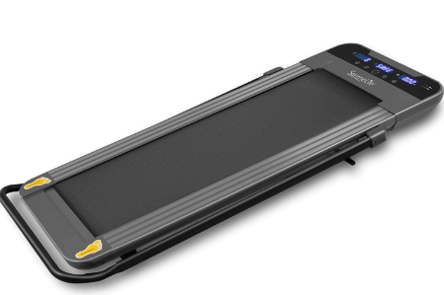
PROJECT TITLE
COMPACT, PORTABLE TREADMILL
Image for representative purposes

Slide 3
GROUP MEMBERS:
Mukul Ganwal - 18BME0628
Shaurya Thakur - 18BME0630
Sahil T Chaudhary - 18BME0668
Kahaan Patel - 18BME0690

Slide 4
INTRODUCTION
Since the beginning of COVID-19 pandemic and the implementations of lockdowns, outdoor exercise and gymming took a back seat. Hence, to avoid that, a compact portable treadmill is introduced which is a new foldable treadmill that literally fits under the bed and is trying to change that so that you can exercise in the comfort of your own home or office without needing the space that a traditional treadmill would require.
This treadmill gives the opportunity to stay active while they check emails on their phone, watch TV or perform some other activity that would otherwise eat up exercise time. Its specific build and materials allow it to be light, portable and convenient. This mitigates the limited motivation problem by bringing the barrier to entry of exercise way down.

Slide 5
APPLICATIONS
It provides a straight forward, efficient aerobic workout. It is so small that it can be used anywhere, either in your office or at your home and can be fit below/inside your bed.

Slide 6
CONCLUSIONS
Finally, the product as a whole is a completely new step into the lifestyle-tech/fitness device sector, allowing people to effortlessly blend physical activity with their daily lives either at work or at home. It makes fitness easy and accessible with its portable, compact, and lightweight design. Also, the device is much quiet and do not tend to disturb any neighbours or people around. There is also a child safety lock that prevents children from triggering the running surface reducing the potential for accidents.
Hence such types of treadmills are a great necessity in current situation where whole world is suffering due to COVID-19 and especially for those who love to exercise and for those who need to exercise for their well-being.

